Slide 1
Closest pair of points

Slide 2

Problem Statement
We are given an array of n points in the plane and the problem is to find out the closest pair of points in the array
Distance between 2 points:

Slide 3
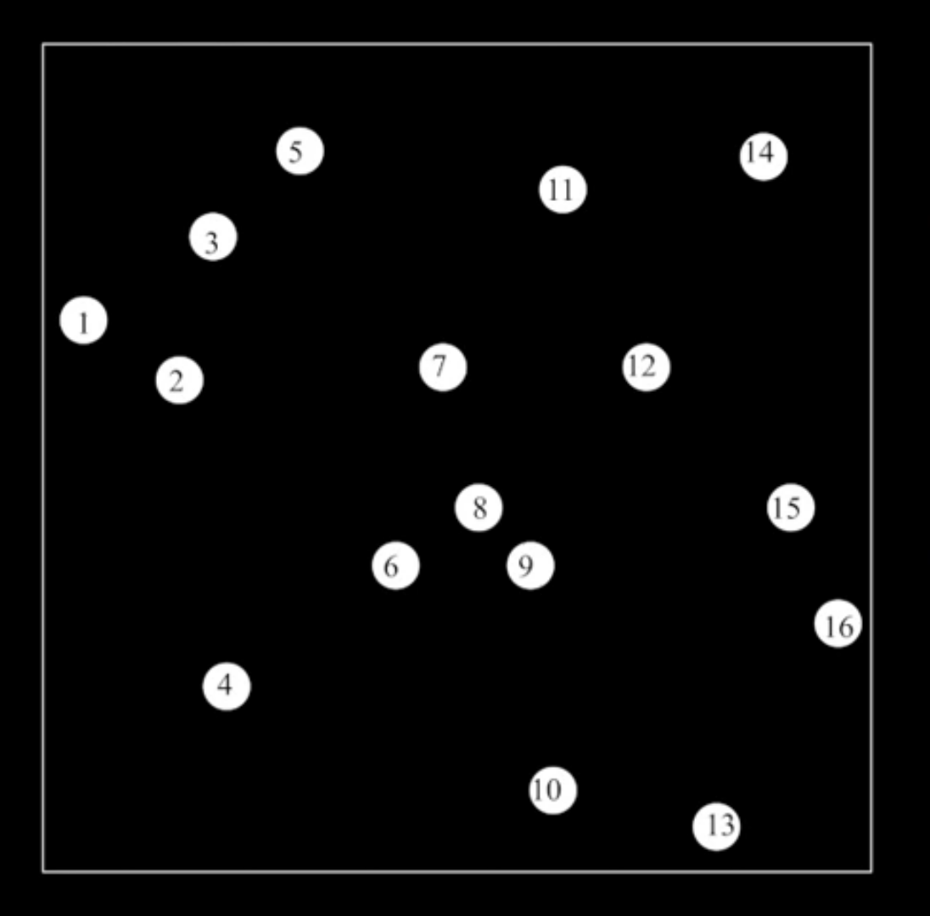
How to approach:
Step 1: We store the x coordinates and y coordinates separately into 2 different arrays . Let us assume it as Px[] and Py[].
Step 2: Sort the array Px[] and Py[]. (Quick sort).
Now we will be working on the array Px[].
Step 3:Find the middle point in the sorted array. We take middle point as Px[n/2].
Step 4: Divide the given array into 2 halves. The first sub array contains points from Px[0] to Px[n/2]. Second sub array contains points from Px[(n/2)+1] to Px[n-1].

Slide 4
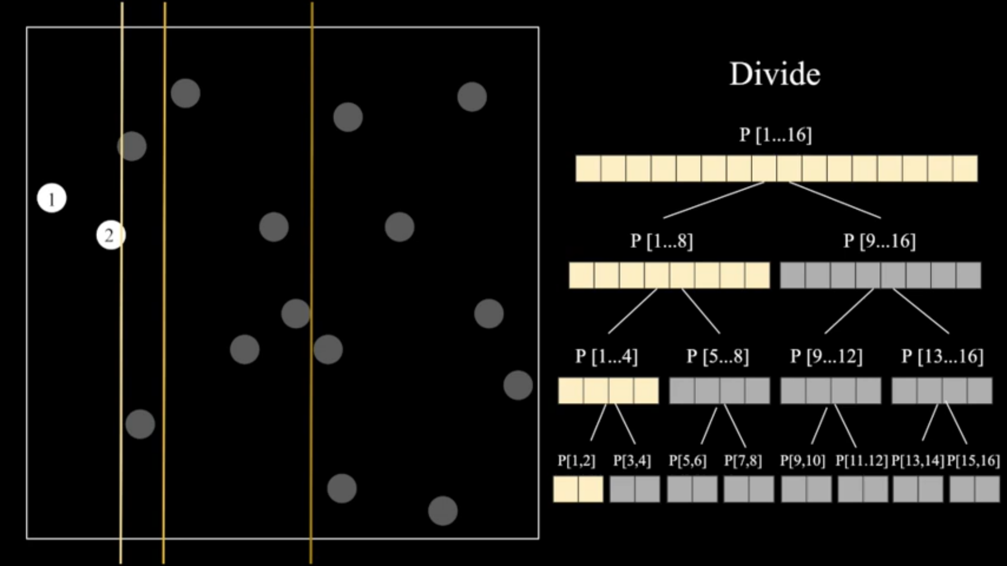

Slide 5
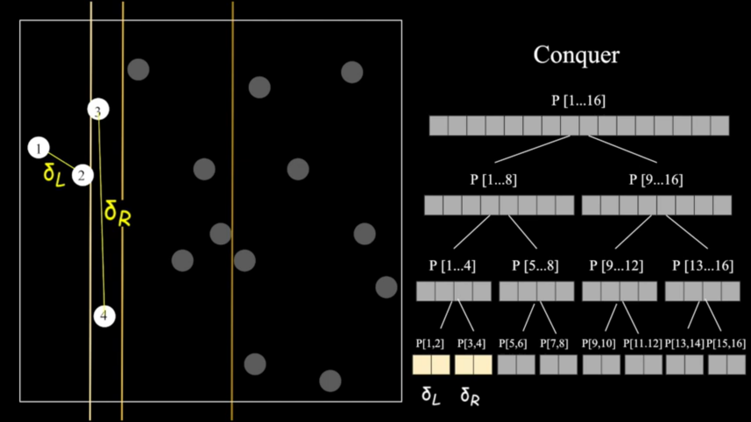
Step 5: recursively find the smallest distance in both sub arrays. Let the distances be dl and dr and find the minimum of dl and dr which we call it as d.

Slide 6
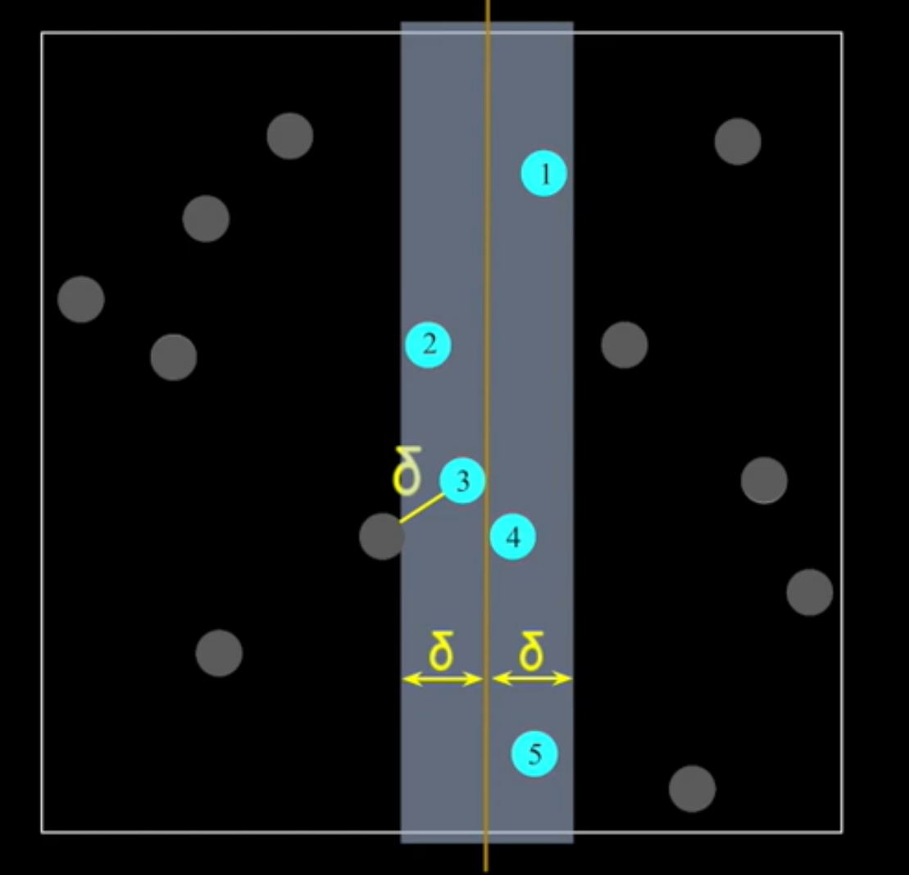
Step 6: Consider the vertical line passing through Px[n/2] and find all the points whose x coordinate is closer than d to the middle vertical line. Build an array strip of such points.

Slide 7
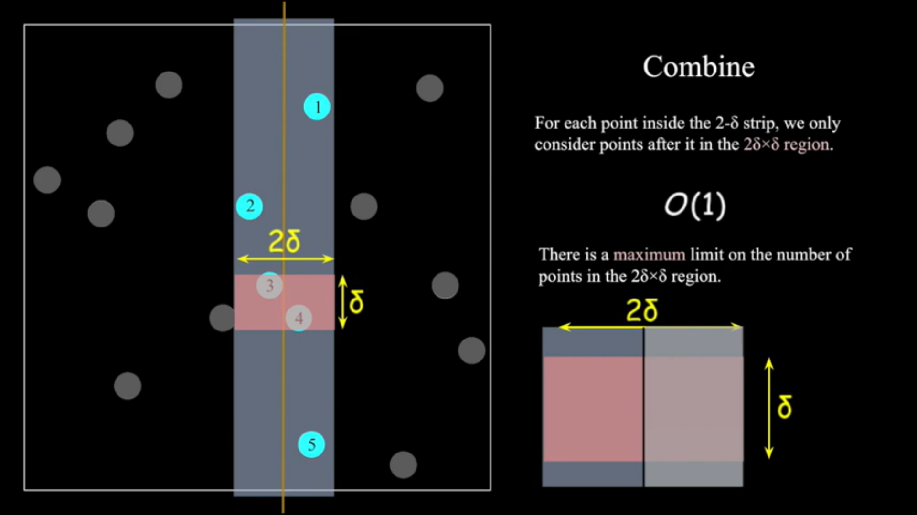
Step 7: Extract Y coordinates from Py[] for the points inside the strip. We find the smallest distance in the strip(ds).
Step 8: We find minimum of d and ds.

Slide 8
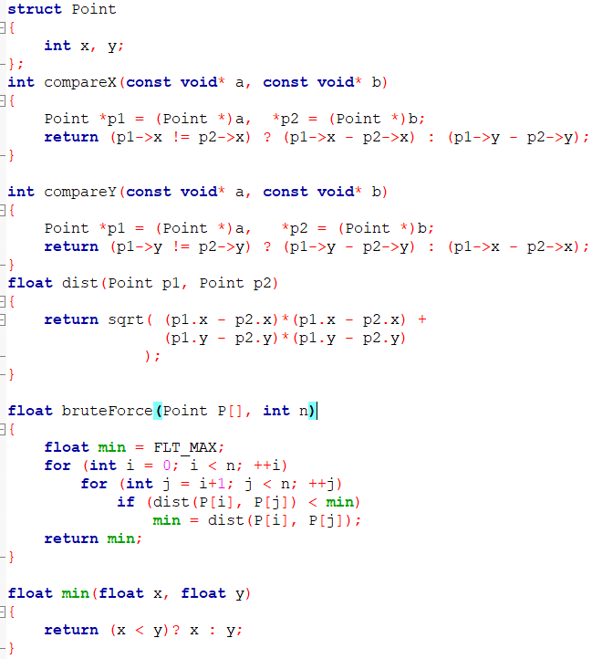

Slide 9
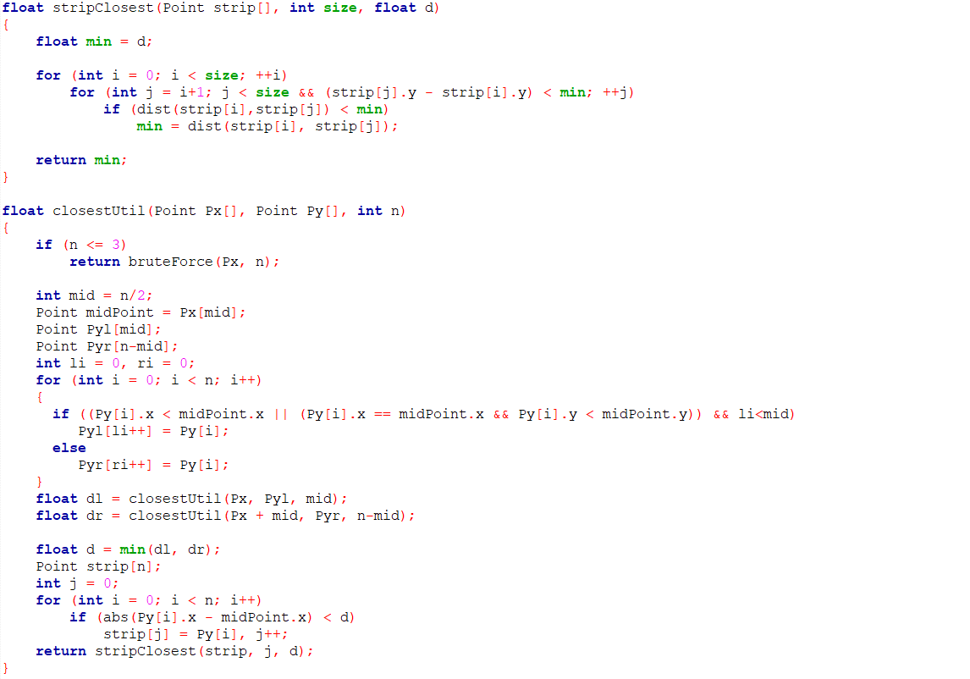

Slide 10
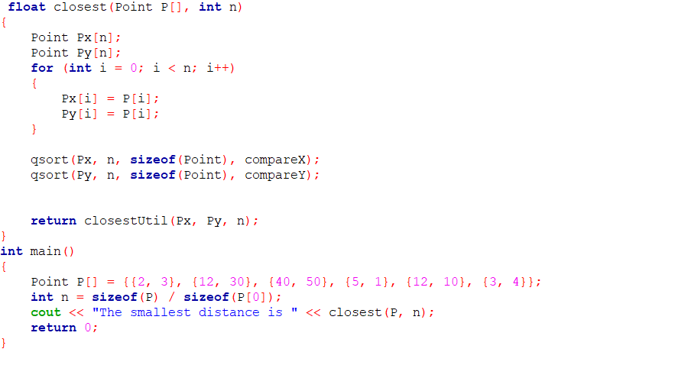

Slide 11
TIME COMPLEXITY :
Let Time complexity of above algorithm be T(n).
To calculate the median of the array - O(n)
To calculate smallest distance in left and right sub array - 2T(N/2)
Time to divide the Py[] array in the mid vertical line - O(n).
To Find closest point in the strip - O(n).
T(n) = 2T(n/2) + O(n) + O(n) + O(n) T(n) = 2T(n/2) + O(n) T(n) = T(nLogn)

